Slide 1
S5: Data Abstraction
CS1101S AY20/21 Sem 1
Studio 2D
Lee Wei Min
Notes:
Add studio name

Slide 2
Mastery Check
One team has already completed
Please book by this week

Slide 3
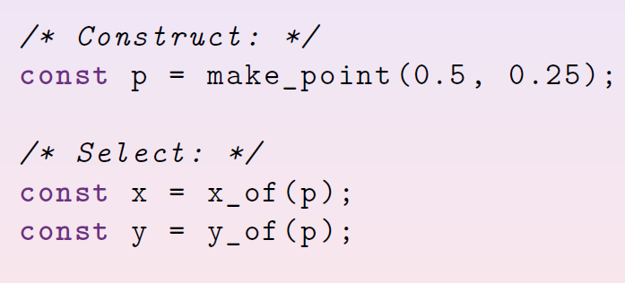
Points

Slide 4
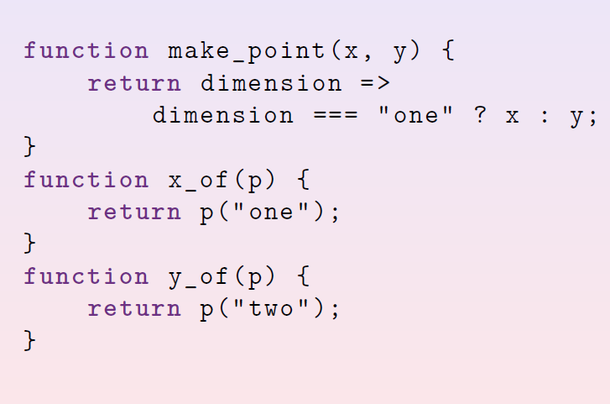

Slide 5
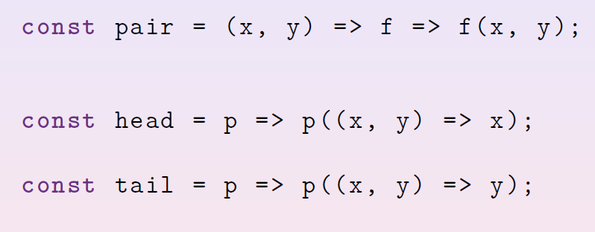
Functional Expressionism

Slide 6
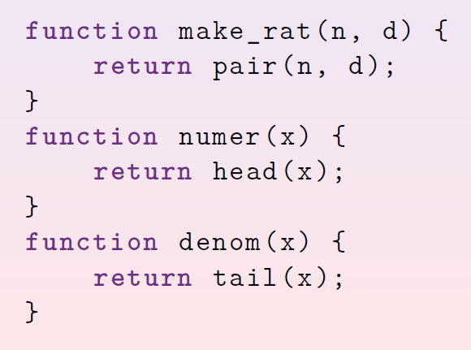
Rational Numbers

Slide 7
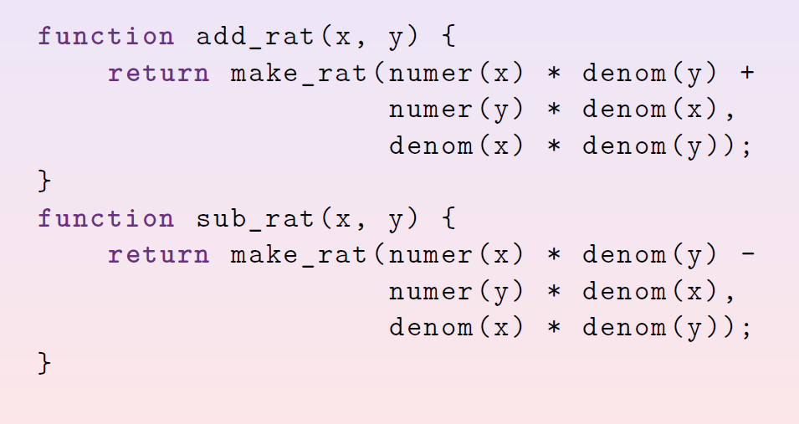

Slide 8
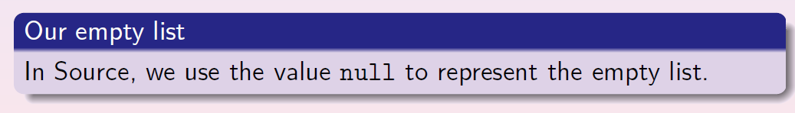
List

Slide 9
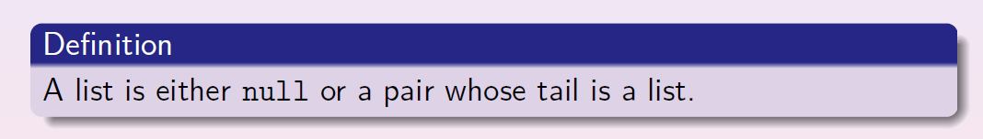

Slide 10
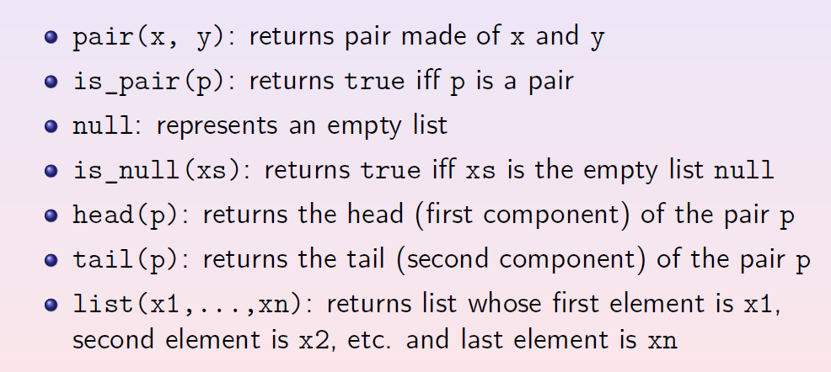

Slide 11
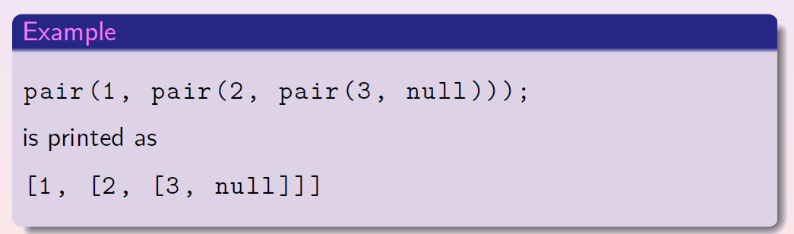
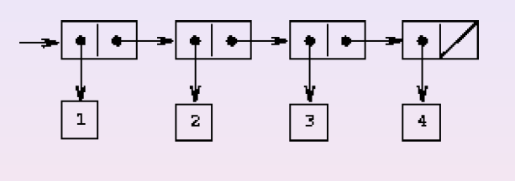

Slide 12
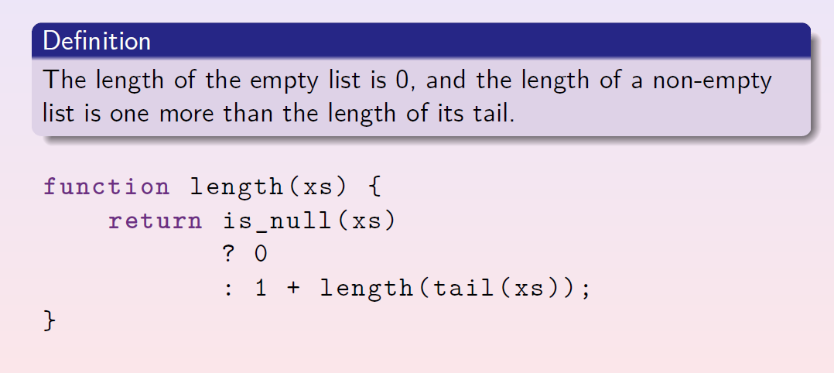

Slide 13
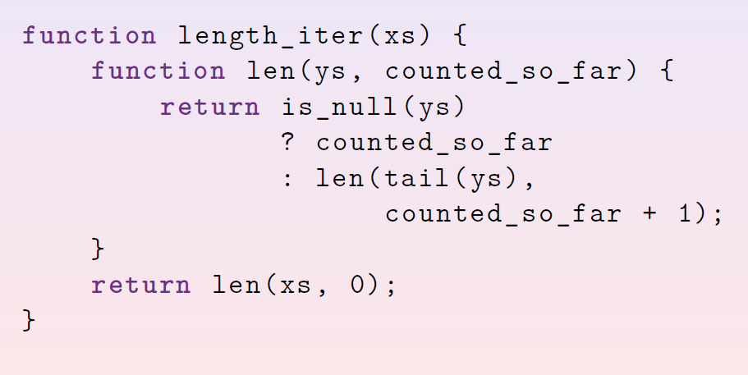

Slide 14
Studio

